Slide 1

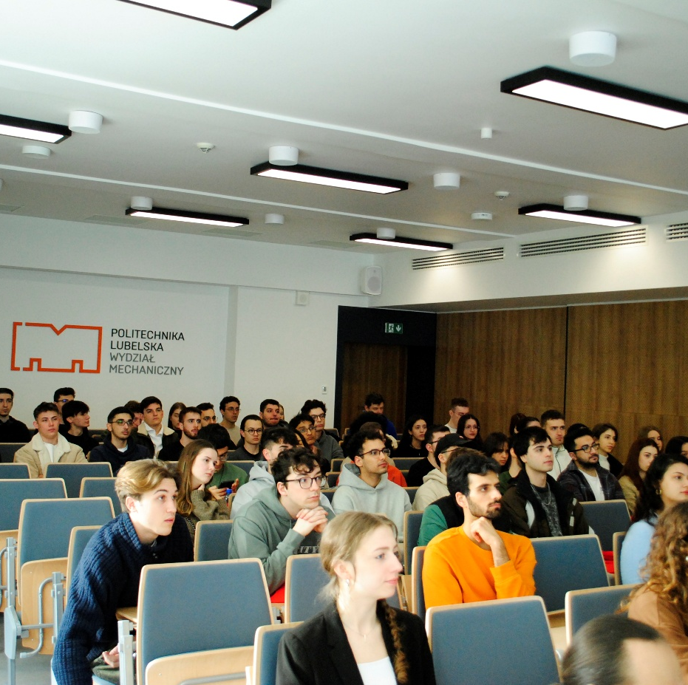

Welcome Meeting
A meeting at the beginning of the semester, introducing new students to academic life and the opportunities offered by Erasmus.

Slide 2
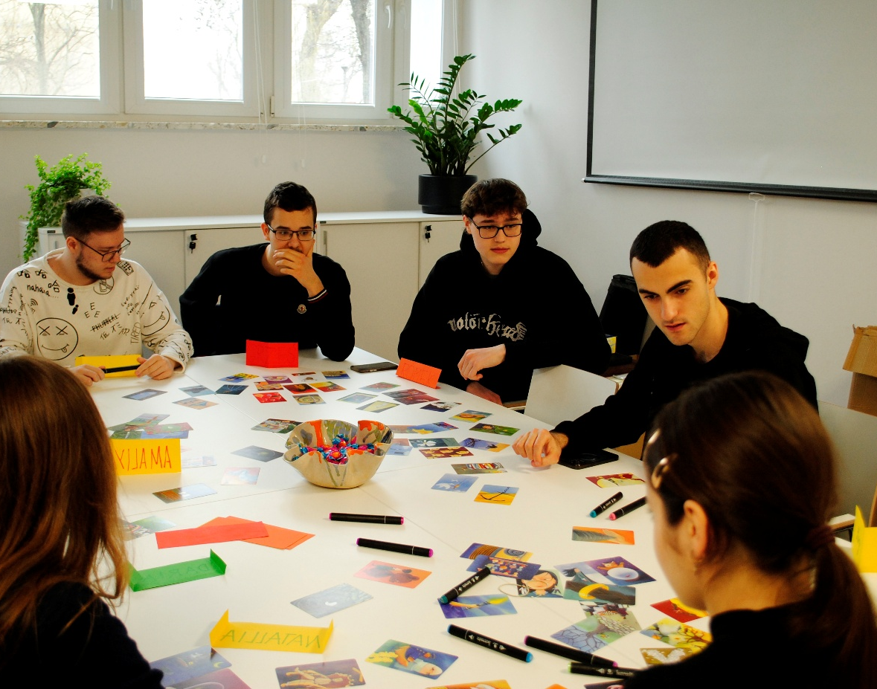
Workshops on intercultural communication as part of Erasmus training
Practical classes teaching how to best understand cultural differences and communicate effectively in an international environment.

Slide 3
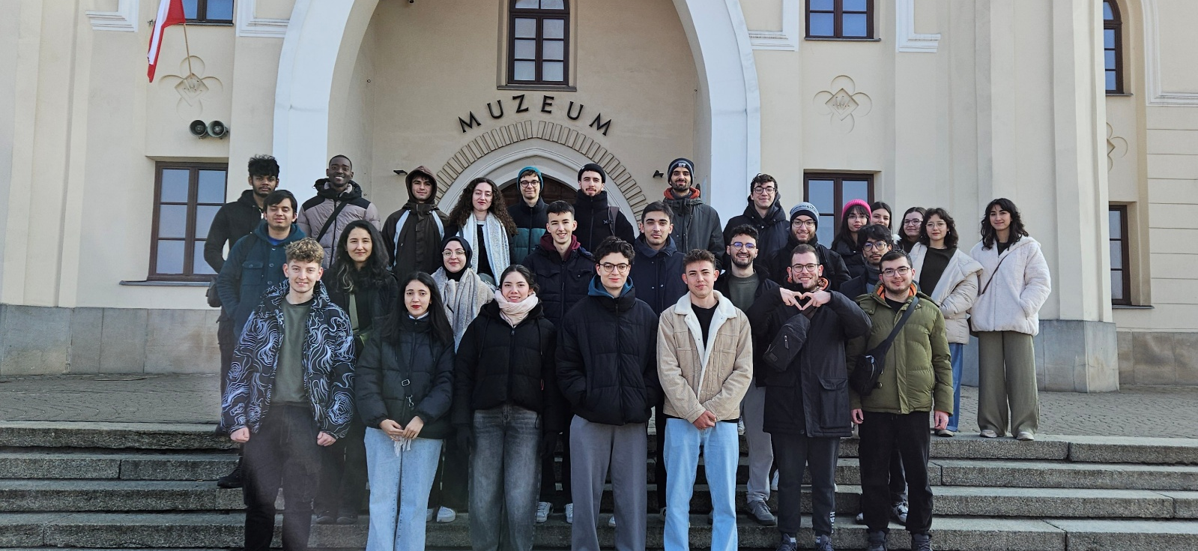
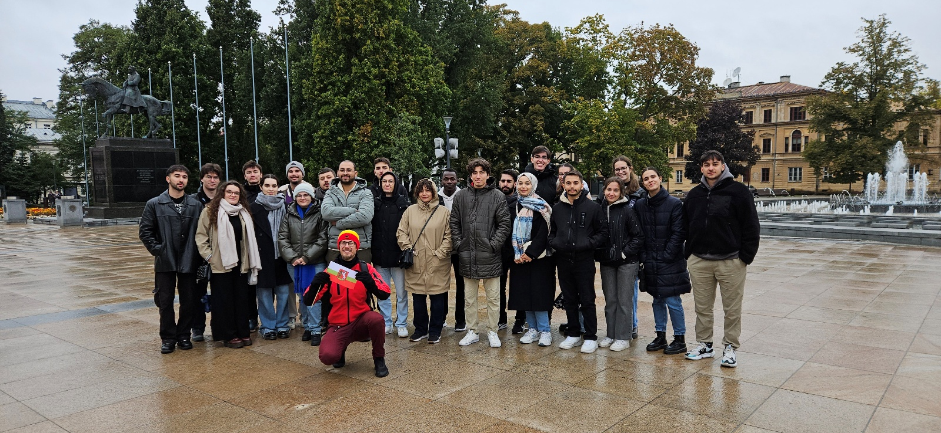
Orientation Days
Several days full of informational meetings, workshops, and tours of Lublin. Thanks to these, students can more quickly find their feet in their new environment, learn about the culture and history of the city, and get to know their peers.

Slide 4
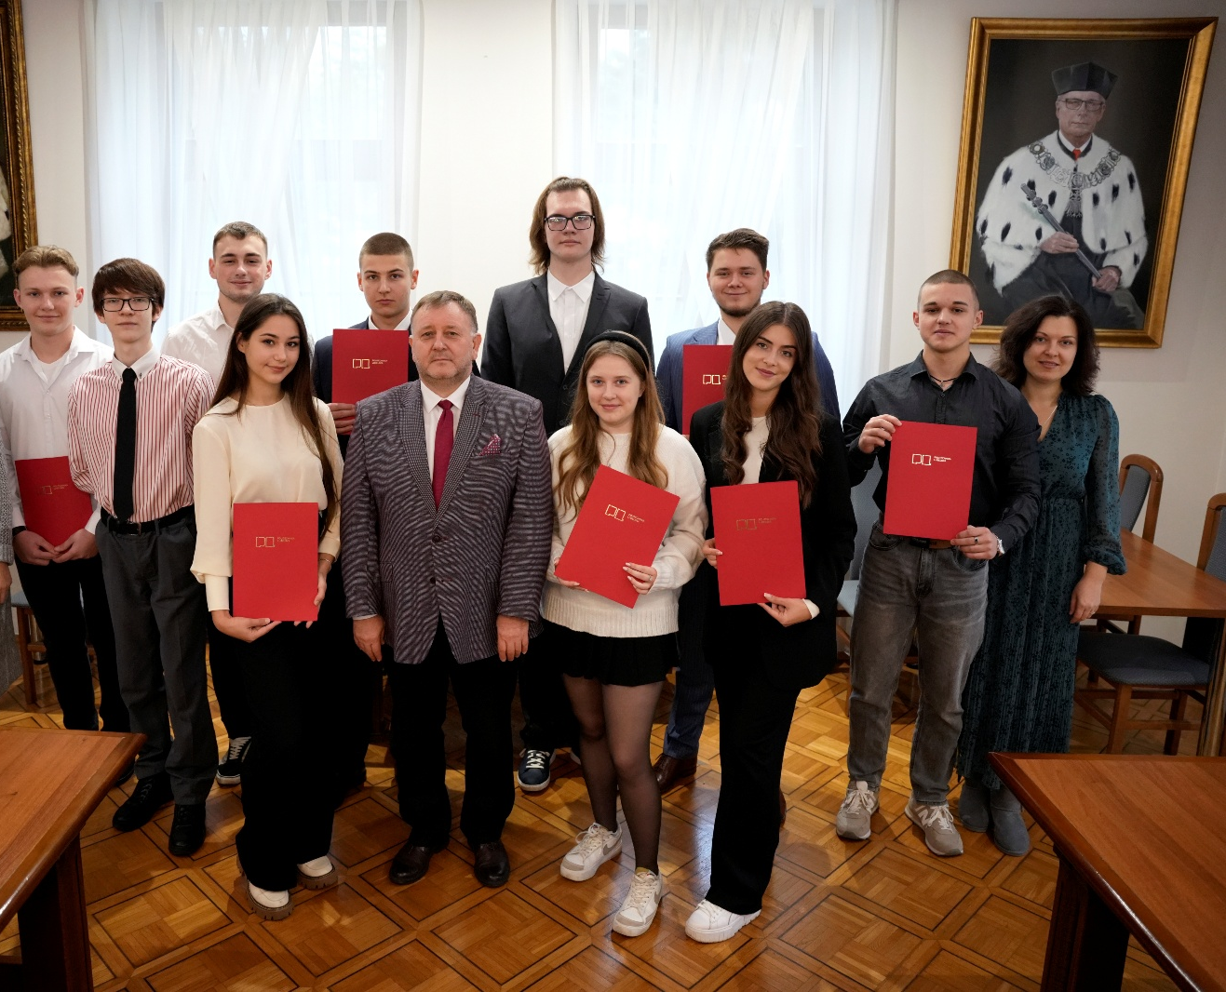
It's Worth Being the Best” Competition
A competition open to foreigners studying in Poland on a full-cycle program in Polish. Its aim is to reward commitment and outstanding academic achievements.

Slide 5
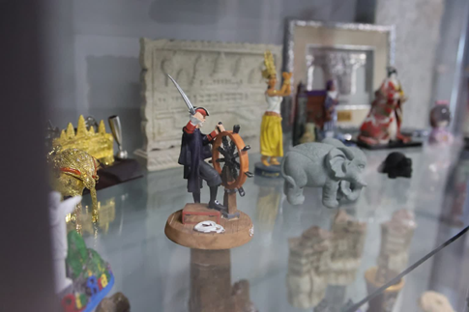
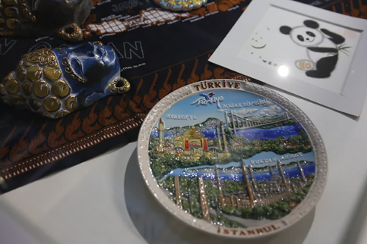
Exhibition “Treasures of Erasmus”
An exhibition presenting souvenirs, photos, and memories of foreign students. Dedicated to the 25th anniversary of the Lublin University of Technology's participation in the Erasmus+ program.

Slide 6
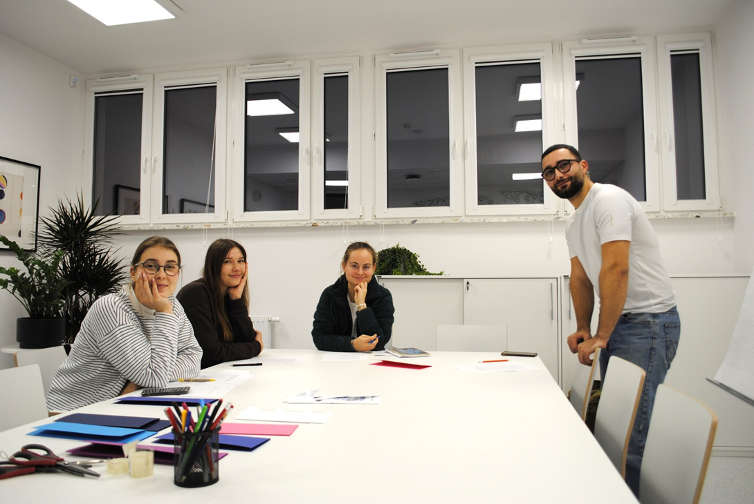
Spanish Corner at BKM
Conversational Spanish classes with Erasmus students. This is not only an opportunity to learn the language in practice, but also to learn about the culture of Spanish-speaking countries.

Slide 7

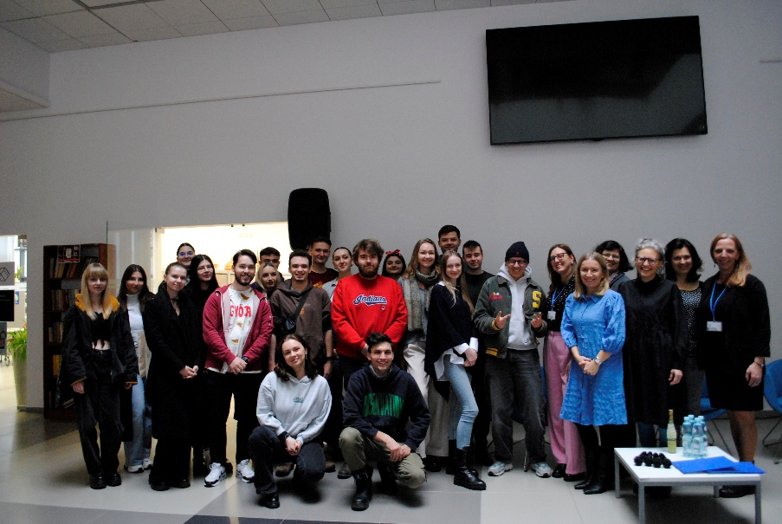
Screening of the film “I am Erasmus”
A screening of a film showing the story of a student participating in an exchange program. It was accompanied by a discussion panel with the director and program participants, which allowed for an exchange of experiences and reflections.

Slide 8
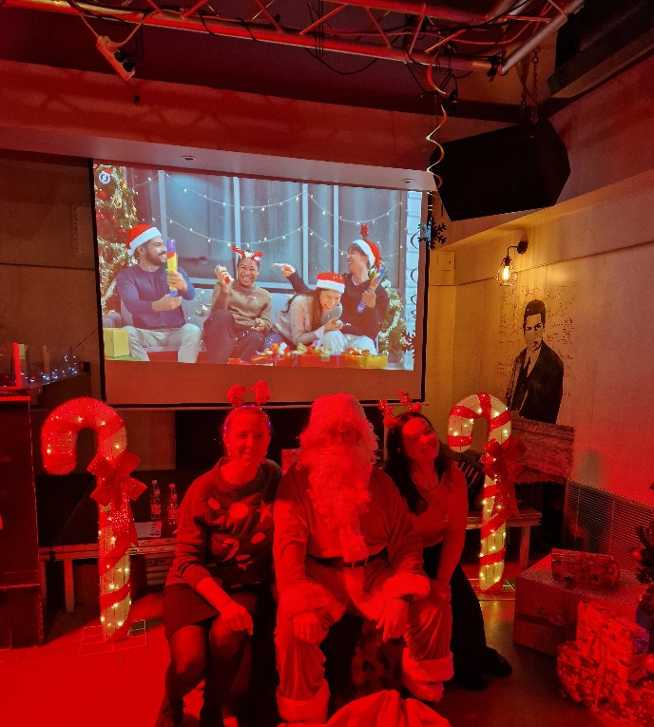
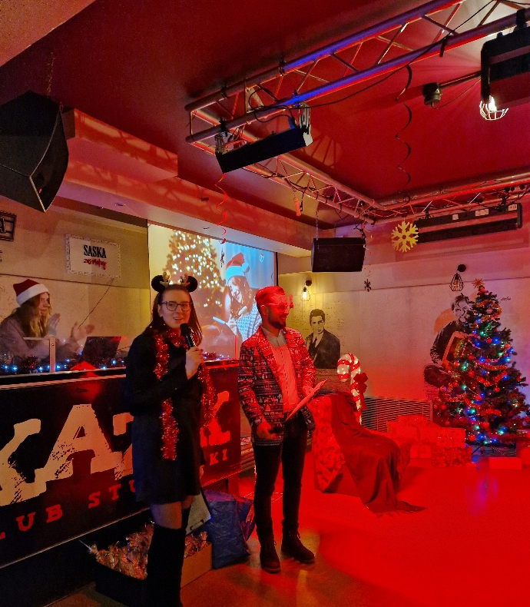
Winter Party
A winter integration party for Polish and foreign students. It is a time for having fun together, exchanging experiences, and building international friendships.

Slide 9
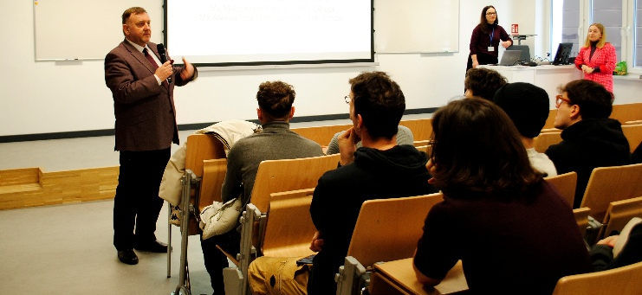
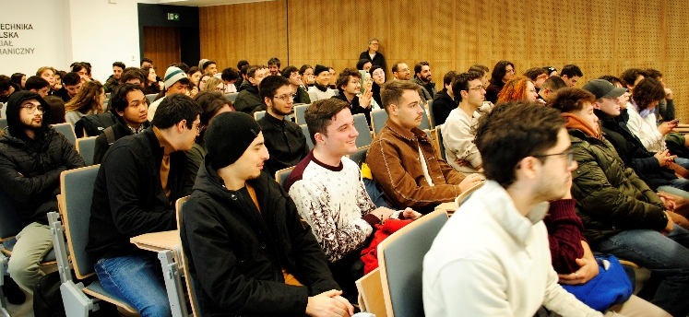
Farewell Meeting
A meeting at the end of the semester, during which students reminisce about their shared experiences. It is also a moment of official farewell.

Slide 10
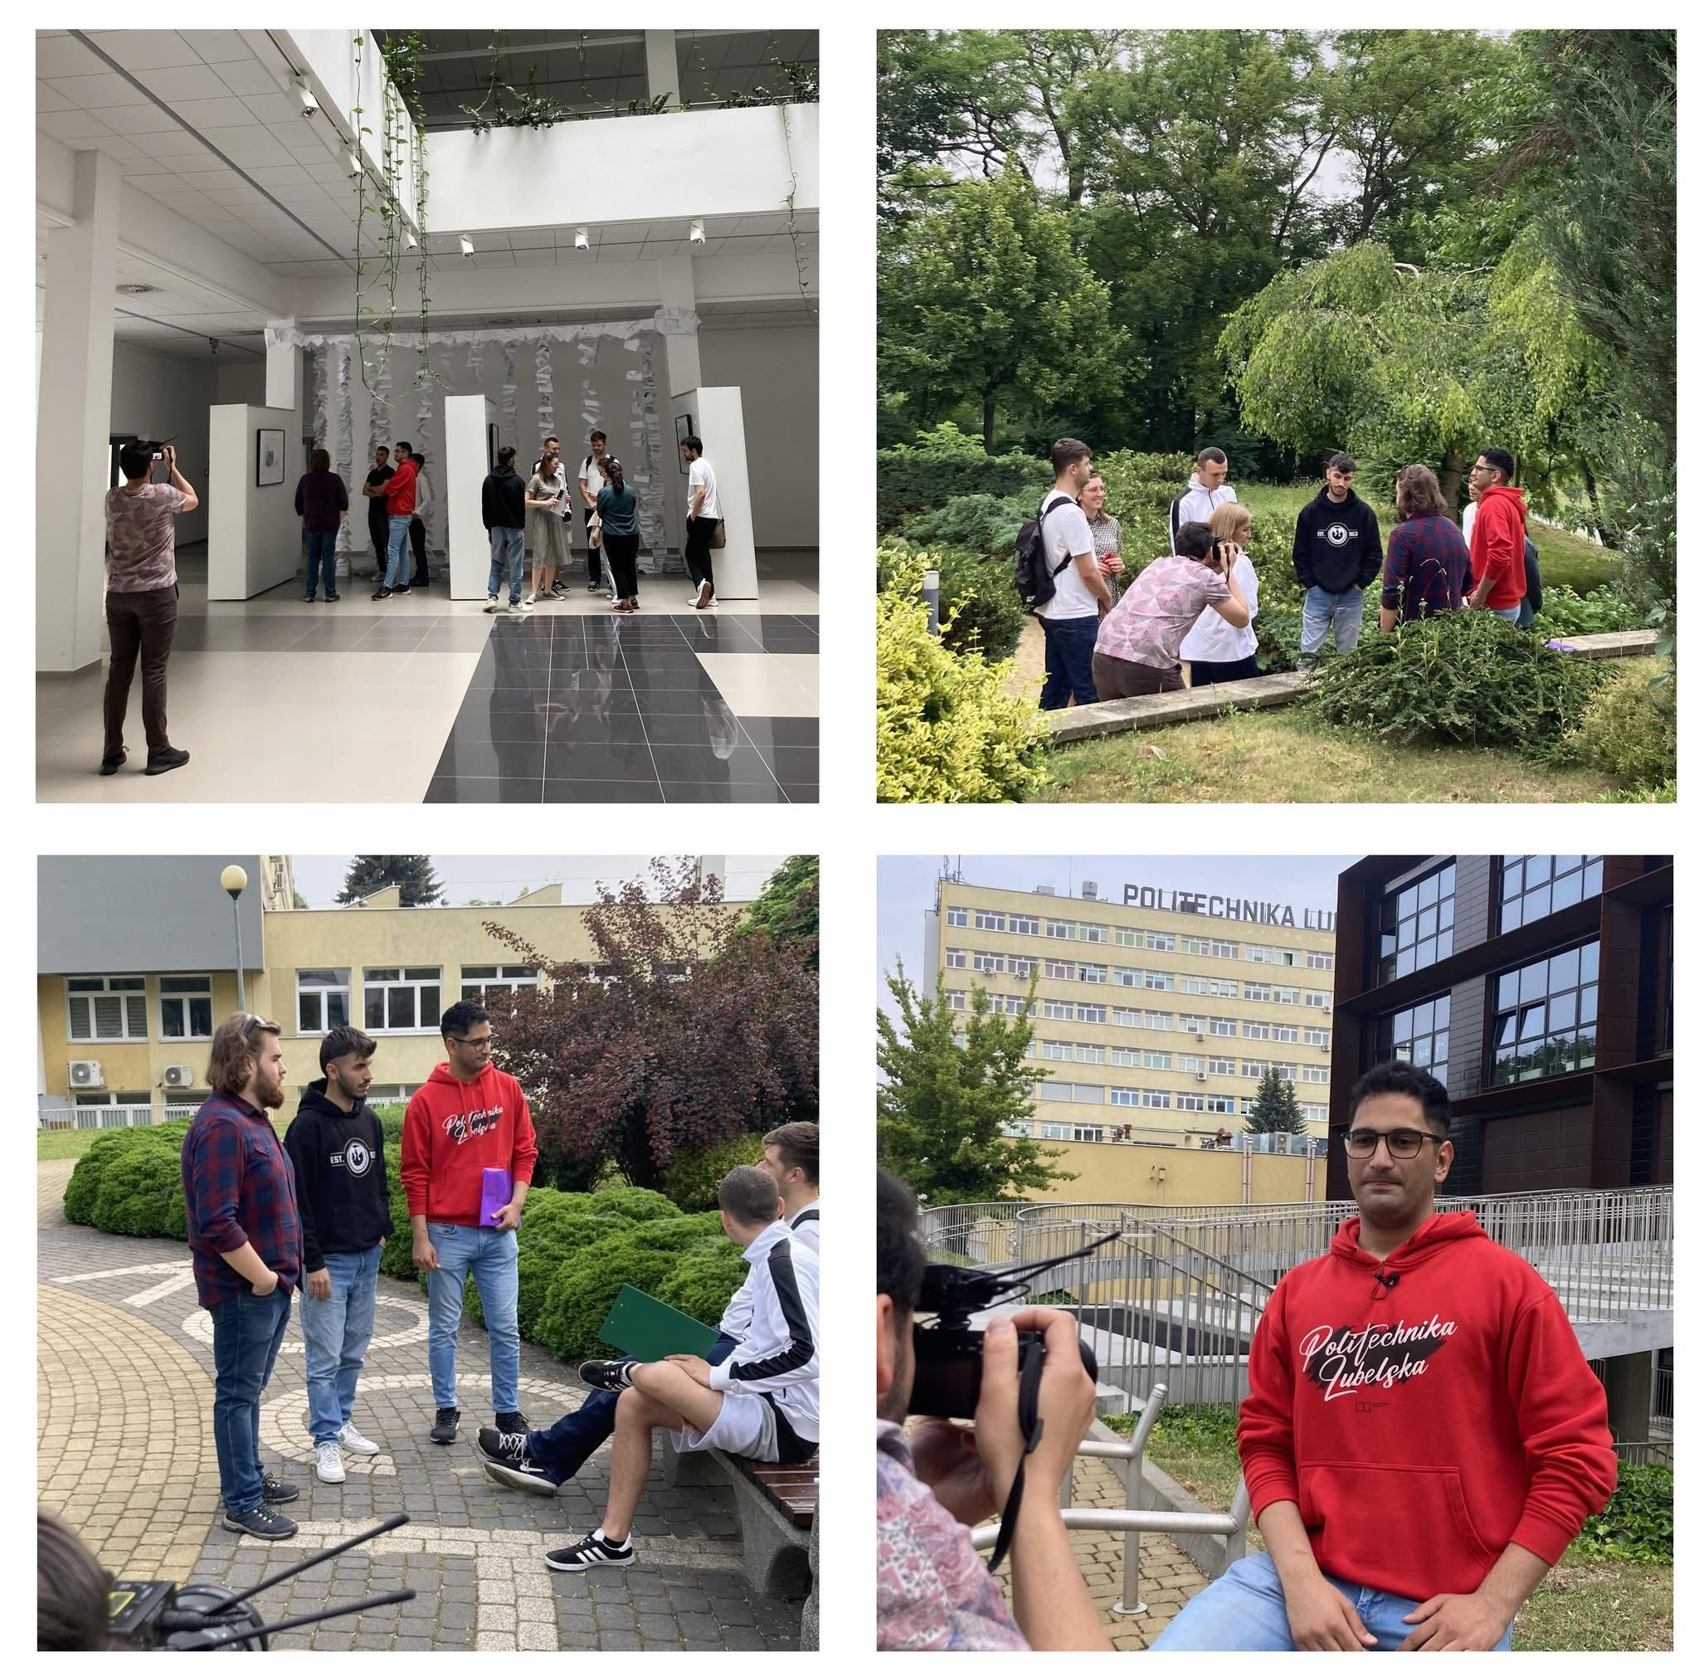
Photos for a video clip “Erasmus Rocks!”
Photos for a film promoting the Erasmus program, showing its most interesting aspects.

Slide 11
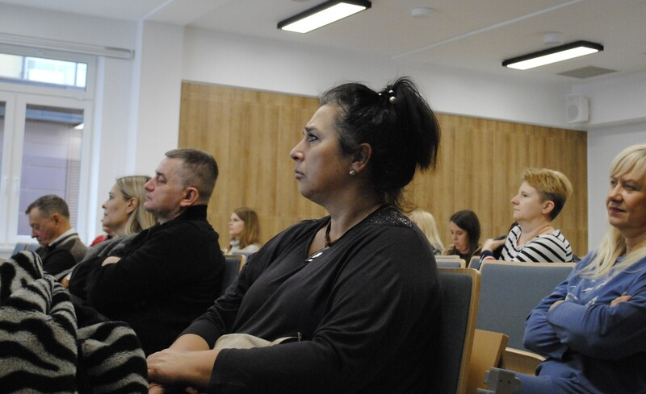
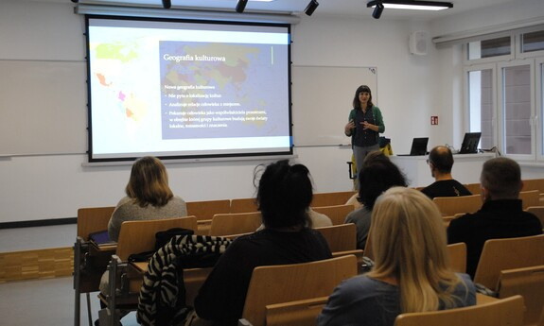
Workshops on intercultural communication as part of Erasmus training
Training to support university staff in their work with foreigners. Participants gain knowledge that facilitates cooperation in an international academic environment.

Slide 12
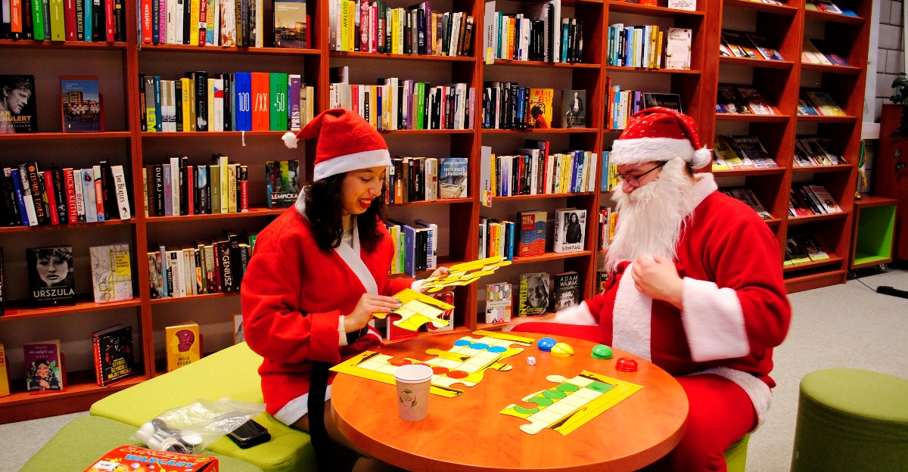
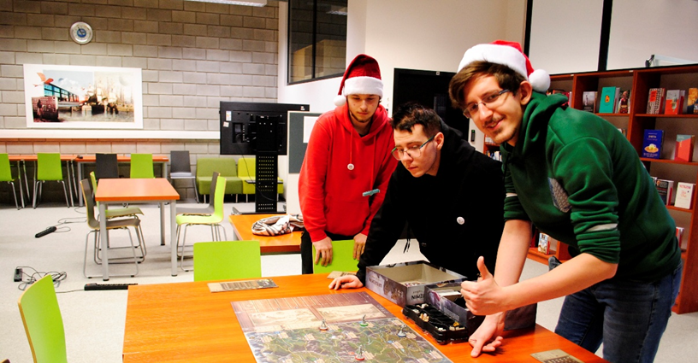
Erasmus Day and board games
An integration meeting organized in cooperation with the Carbon Scientific Club. It is a form of building relationships between students through games, conversations, and fun.

Slide 13
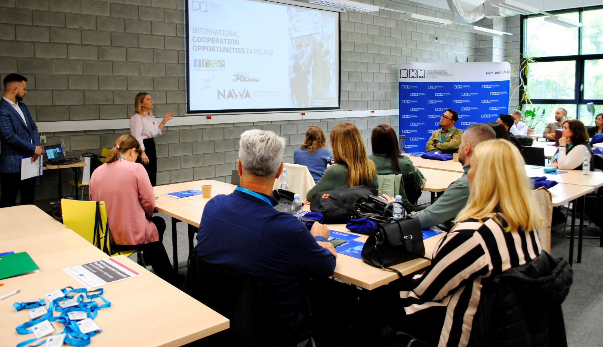
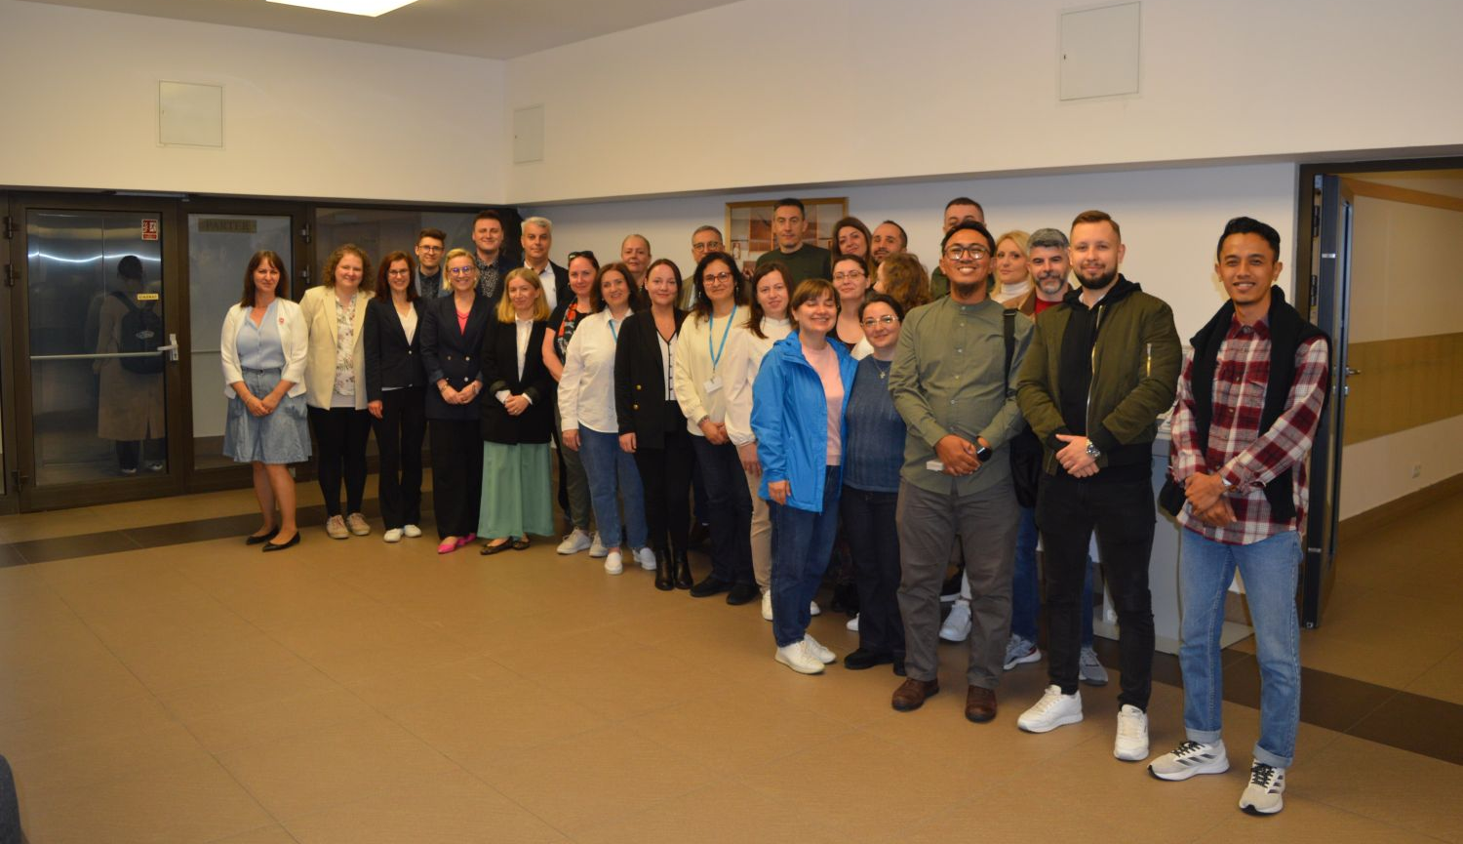
Staff Week
A week of events for employees of partner universities from abroad. It serves to exchange experiences, present good practices, and develop international cooperation.

Slide 14
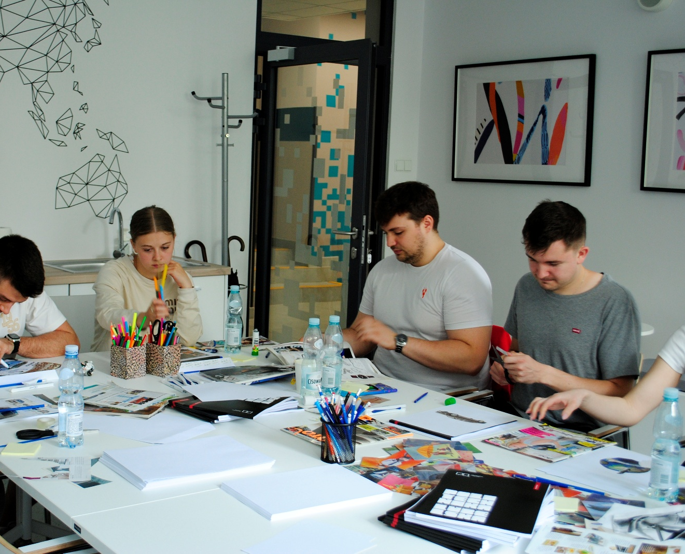
Workshops for students qualified to study or do an internship abroad
Classes preparing students for their trip, including relocation training, personal branding, and English language courses. Thanks to these classes, students gain the confidence and practical skills they need abroad.

Slide 15
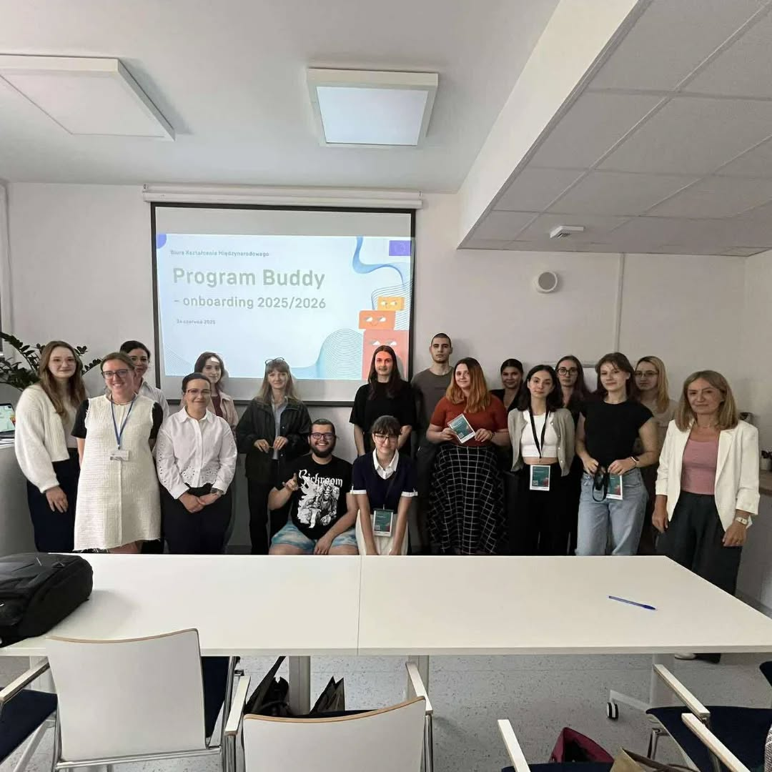
Buddy Program
An initiative supporting the integration of Polish students with exchange participants. Polish student mentors help new colleagues find their way around Lublin, complete formalities, and feel part of the academic community.

